Slide 1
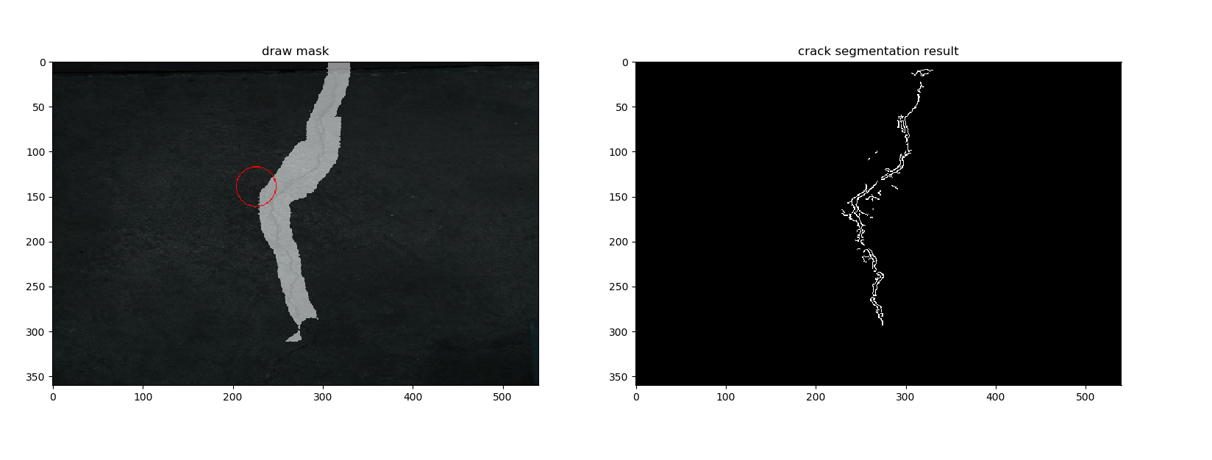
crack segmentation tool

Slide 2
feature
paint brush
  paint on crack area
  clean the painted mask area
  adjust paint radius
Segmentation
  opencv Grabcut
  Canny edge

Slide 3
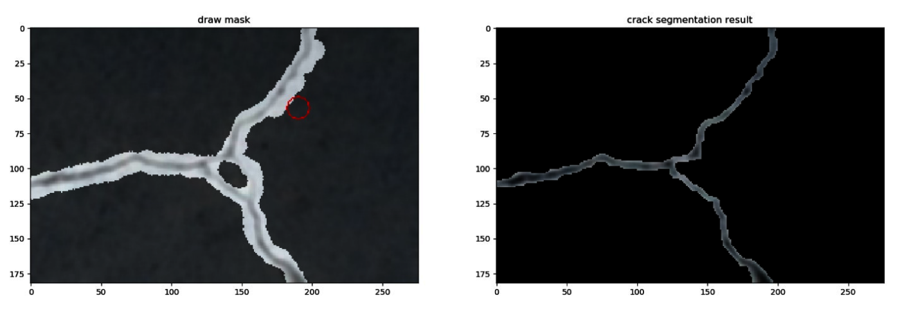
grab-cut
Just works when the surrounding area is different from crack area
Fail when crack is small and looks similar to the background (pavement)

Slide 4
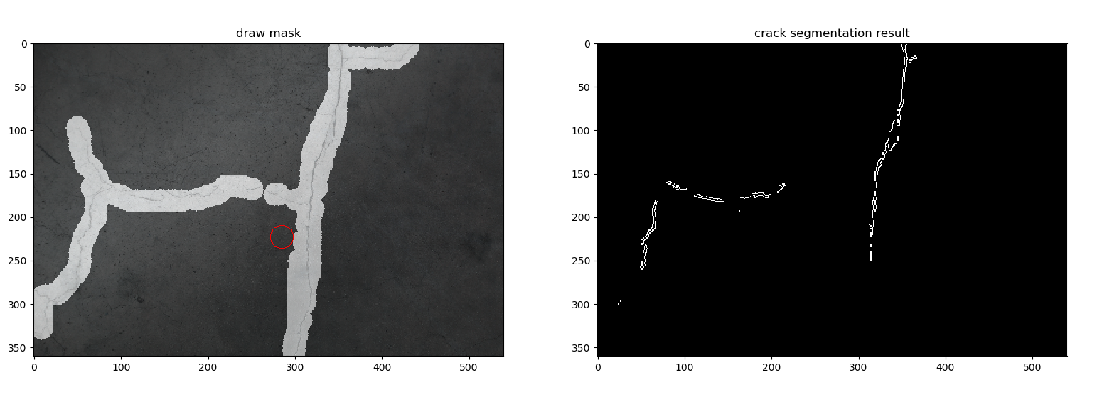
Canny edge

Slide 5
Canny edge
Threshold calculation
  Median of all gray pixels in the painted area
  Lower: median – 0.3
  Upper: median + 0.3
Problems
  Lot of noise
  Missing crack lines

Slide 6
Next step
segmentation
  Cut the painted area into smaller segments?
    Calculate canny edge threshold per segment
  Tried different adaptive threshold method?
  Other idea?

